Slide 1
VR Brain Games
Done By: Winston ;P

Slide 2
-1-
-2-
-3-
Analysis of Brain Games
Advantages of VR Games
Senior Accessibility
Market Research
Concept Ideation
Table Of Contents
-4-
-5-

Slide 3
Analysis of Brain Games
1
“Lobotomy”
Jiaxu 2024

Slide 4
Brain Function Improvement
Designed to stimulate various mental functons and promote cognitive abilities, improve memory and main or boost overall mental acuity
Areas of improvements include:
Memory Improvement
Problem-Solving and Critical Thinking
Attention and Concentration
Processing Speed
Language and Linguistics Skills
Spatial Awareness and Coordination
Numerical Processing

Slide 5
Advantages of VR Games
2
Immersion in Virtual Lives

Slide 6
Virtual Games, Virtual Players
Immersion within virtual environments, opportunities with less risk as well as access to rare and hard to come by experiences. Being in the moment allows for uses to see for themselves and participate actively in the games.
Benefits include:
Immersiveness promotes focus and engagement
Hands on Interactions and first hand experience increases memorability
Adapt to different learning styles
Direct and real time assessment on the player’s performance
Pushes boundaries and rules onto gameplay to tailor growth

Slide 7
Senior Accessibility
3
Design for Elderly Audience

Slide 8
Our Senior Audience
Each VR headset has controllers that fit into the hand of the user comfortably while the buttons are close to each finger to reduce strain as well as fit with smaller handspans. There are also adjustable viewing lenses and audio feedback to cater to head size, face shape and other individual uniqueness.
Controls are usually based on hand gestures with pointing or grabbing motions, with buttons near the expected position for familiarity.
Safety measures and comfortable user experience can be designed by the developers to ensure that the game is played in a safe environment while the design of the application should be minimally invasive to the user’s perception.
Fear of technology and surrendering control to a device can be a turn away for some, thus the view should be rather realistic with some level of comfort and cuteness to it, reducing the harshness or VR games.

Slide 9
Market Research
4
Existing Games on the Market

Slide 10
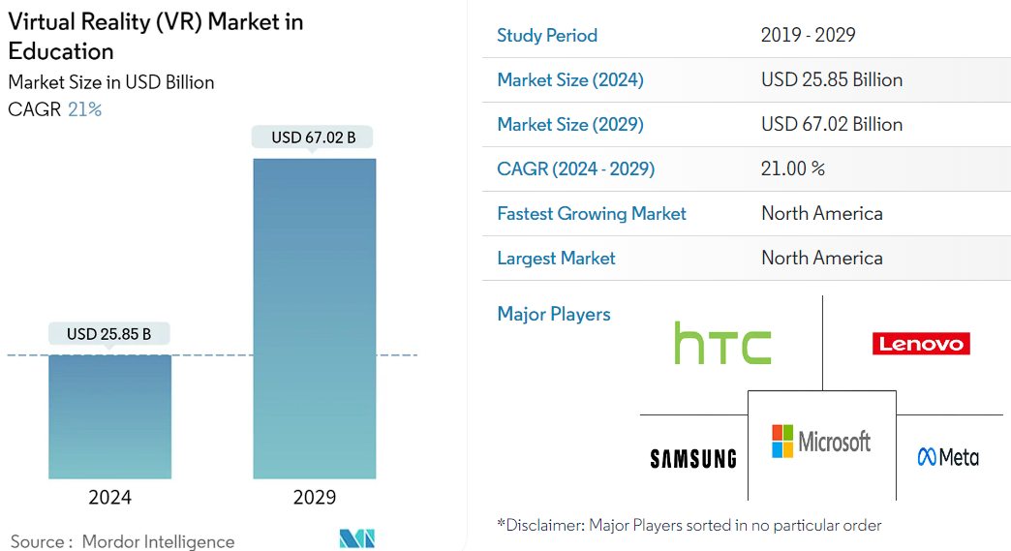
Current Games by Big Brain Academy
Nintendo made 3 variants of the game to cater to a larger audience, focussing on 5 main categories: identify, memorize, analyze, compute and visualize.
Projected growth rate of 21% annually in North America, reporting major monopoly of players in america as well as their larger market pool.
Asia has a smaller audience but still substantial, yet not many reported their findings due to lack of experimentation with VR technology in the education field.
https://www.mordorintelligence.com/industry-reports/virtual-reality-vr-market-in-education

Slide 11
Concept Ideation
5
Our Ideas

Slide 12
Concept
Combining Brain Games and VR Games to allow seniors to experience and learn more skills, improving mental facilities and combat mental aging and the accompanying ailments.
A colorful carnival setting with each game being a stall/booth, giving tokens at the end of the rounds to be used in cosmetics.
The games involve interactions with puzzle pieces in a classroom or carnival setting, promoting spatial awareness and immersion.

Slide 13
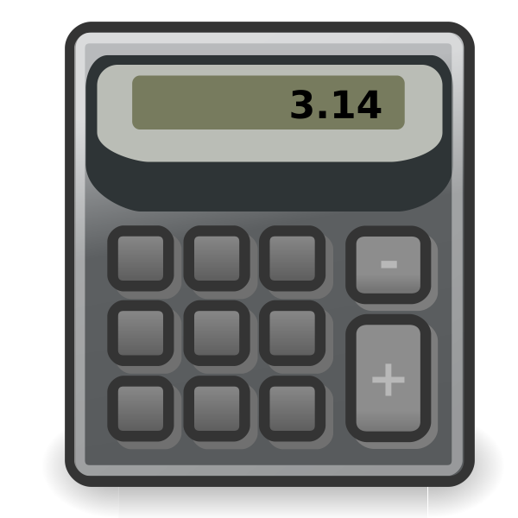
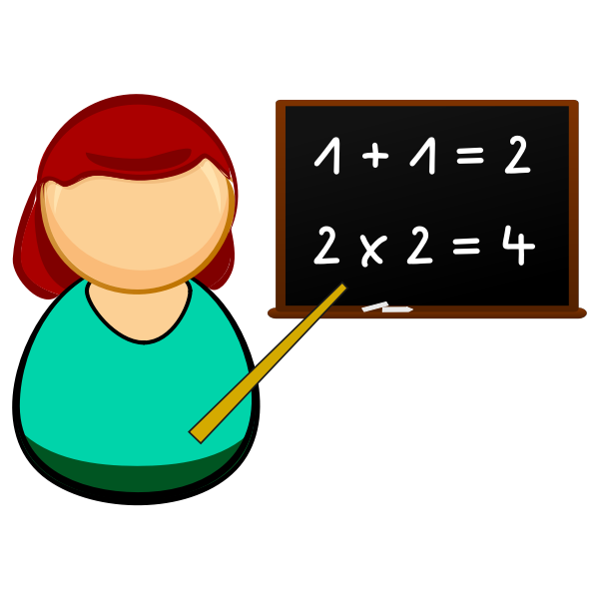
Quick Maths
Given a calculator layout of numbers and operators, as well as floating incomplete math formulas
The table has a keyboard on it as well as a whiteboard/blackboard in front of the user. The keyboard has the same layout as the mobile version. The formulas have ____ spaces to key in values.
Hard version to have simple formulas instead, but they appear for a short time, requiring the user to remember the formula and figure out the required blank____ space answer.
Reversed: given the final answer and space for digit, operator, digit. The user has to select the values and operators to finish the formula
Based on flash memory and reverse retention

Slide 14
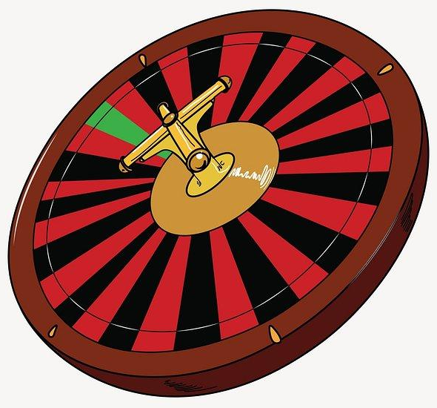







Math Darts
Given a final answer, we give a table with blanks for simple equations. There are floating balloons with numbers and operators. Throwing a dart will then pop a balloon and flash the value/operator on the table. Once all 3 are popped, the value is calculated. If it is correct, points are given. Balancing the scores as well as punishing the player for poor aim is a concern as well as physical constraints or physical strain.

Slide 15
Knock Them Over
Extension of previous game, to give the player a gun to shoot and knock over various wooden pieces. The wood pieces will follow gravity to fall but will not have physics. Wood pieces are of different shapes and have engravings on them. The puzzle can either be mallet match, to remove all the pieces of a certain rule, or to match a shape given by an image. Compared to the previous game, there is less physical strain but also slightly lazier interactions, with raycasts
Based on mallet match and match blast

Slide 16
Puzzle
Given a puzzle board of a grayed out shape as well as a shape at the bottom of the screen, the user has to swipe the piece upwards and into the correct place, if it is correct, it will snap into place and prevent further interaction. If the piece is not needed, then you swipe away in any direction to discard it. A new piece appears, repeating until completed.
Given floating colored particles around the user as well as a puzzle, the user has to randomly grab a particle. The hand will then show a shape. If the shape is required to complete the puzzle, then the user places it on the puzzle board, awarding points if correct. After a set amount of time, the more complete the puzzle is, the more points you get. If you complete a puzzle, then a new one appears. Placing the wrong puzzle shape will deduct points instead.
Based on get in shape and frame filler

Slide 17
Maze Turn
Given a top down view of a maze, the user has to select tetris blocks to move the character to the end.

Slide 18
Q&A
“Why do we need a Q&A Segment”
Jiaxu 2024

